Slide 1
MLB salary Prediction
Phuc Ton Nguyen

Slide 2
Problem identification
San Francisco Giants wants to buy player and they are asking the evaluation of the players on the market to buy.

Slide 3
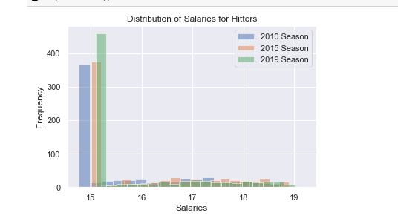
Recommendation and key findings

Slide 4
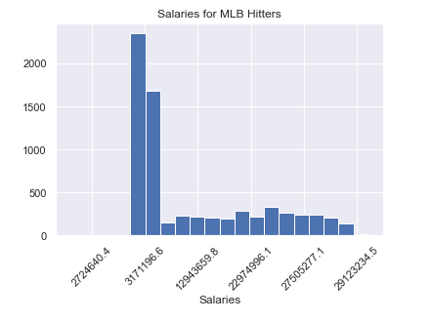
Recommendation and key findings

Slide 5
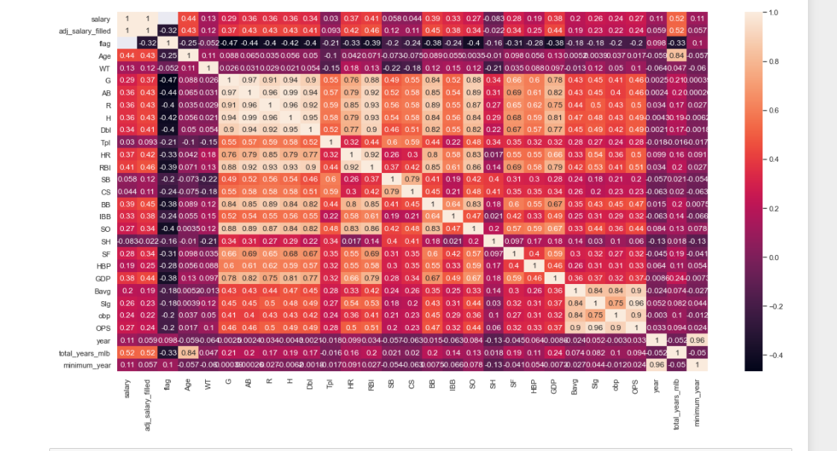
Recommendation and key findings

Slide 6
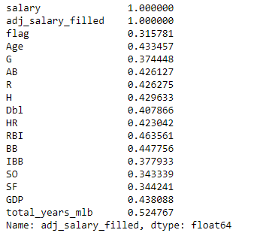
Recommendation and key findings

Slide 7
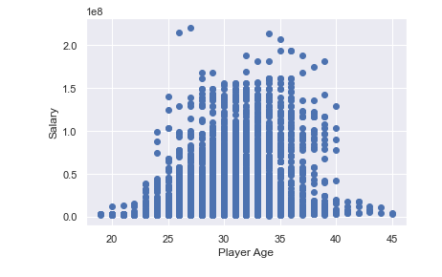
Recommendation and key findings

Slide 8
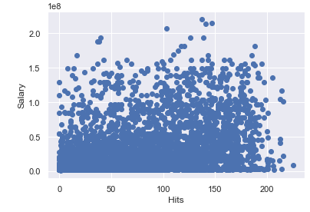
Recommendation and key findings

Slide 9
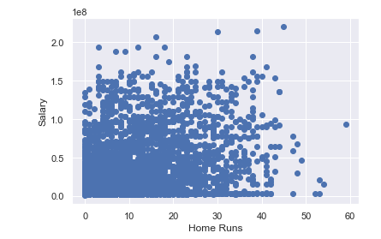
Recommendation and key findings

Slide 10
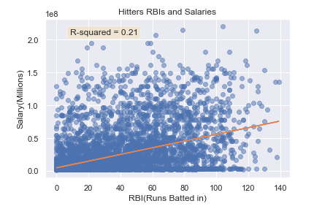
Recommendation and key findings

Slide 11
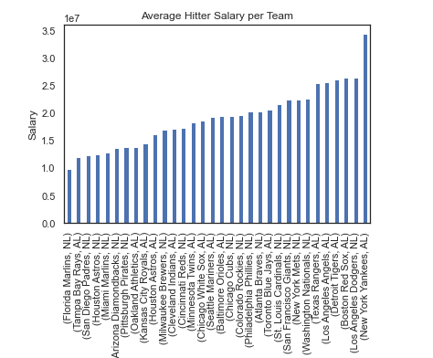
Recommendation and key findings

Slide 12
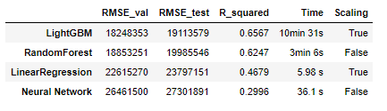
Modeling results and analysis

Slide 13
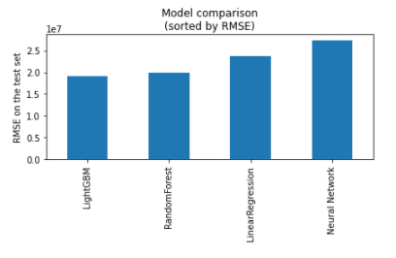
Modeling results and analysis

Slide 14
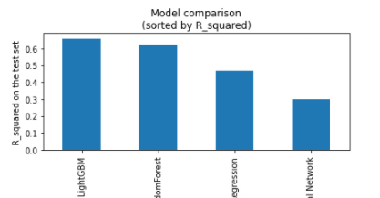
Modeling results and analysis

Slide 15
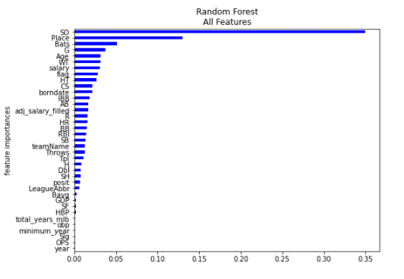
Modeling results and analysis
Important features:

Slide 16
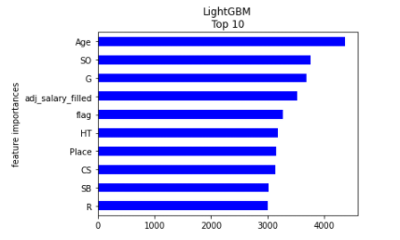
Modeling results and analysis
Important features:

Slide 17
Summary and conclusion
I have found the best MLB salary prediction models is the LightGBM models which showed high speed and best performance in RMSE. If one model should be selected I would recommend to use the LightGBM model since it is faster and it makes fewer outliers.

